Slide 1
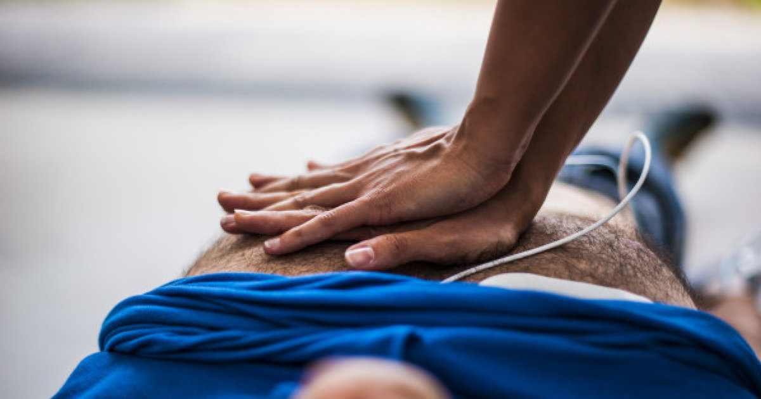
SHOCK IN TRAUMA
Chan Boon Kian

Slide 2
outlines
DEFINITION OF SHOCK
EPIDEMIOLOGY
TYPES
PATHOPHYSIOLOGY - ACOT
SIGNS AND SYMPTOMS OF SHOCKS
APPROACH AND MANAGEMENTS OF SHOCK
RESUSCITATION GOALS AND COMPONENTS
DAMAGE CONTROL RESUSCITATIONS
REFERENCES

Slide 3
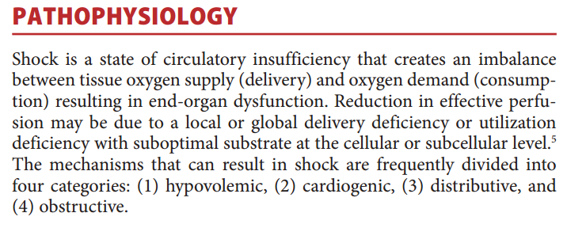
Definition of shock
Tintinalli's Emergency Medicine 8th 2016, Chapter 12, pg. 63

Slide 4
Epidemiology
Global Burden of Disease, 2004
GENEVA: WHO Department of Injuries and Violence Prevention, 2010
50% die before they reach hospital
Uncontrolled hemorrhage or MOF-related shock is the cause of death in about 40% of deaths
20% of hemorrhagic deaths potentially preventable
Dubick MA, et al. US Army Institute of Surgical Research, 2006; report # A508184

Slide 5
Trimodal death distribution
Gunst M, Ghaemmaghami V, Gruszecki A, et al.
Changing epidemiology of trauma deaths leads to a bimodal distribution. Proc (Baylor Univ Med Cent), 2010.

Slide 6
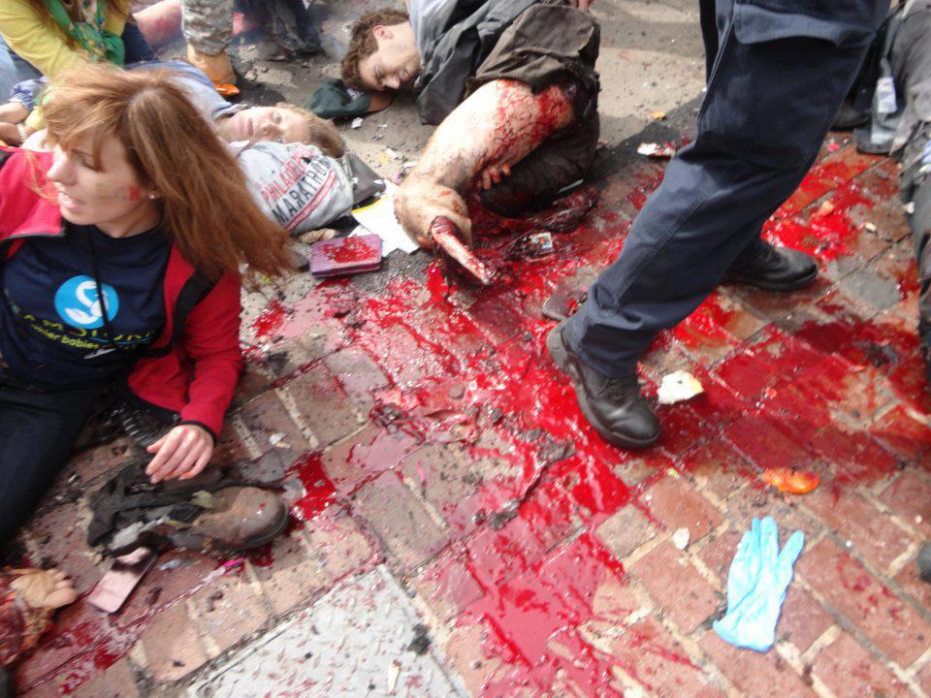
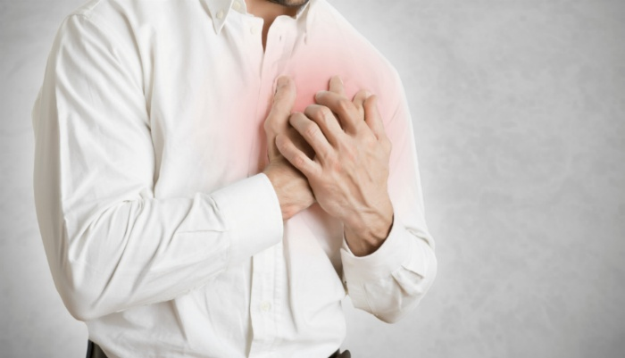
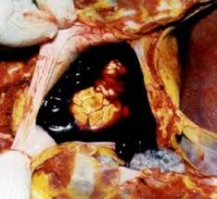
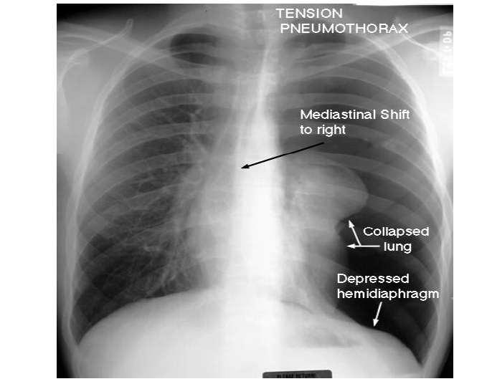
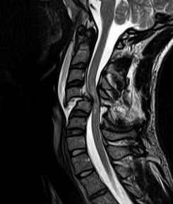
Types
Hypovolemic,
Cardiogenic (relative),
Distributive,
Obstructive.

Slide 7
Pathophysiology
Trauma-induced coagulopathy / Acute traumatic coagulopathy (ATC)
Tissue trauma, inflammation, hypoperfusion/shock (→ activate protein C), neurohumural system activation.
Weibel-Palade bodies (stores vWF & P-selectin) stimulate other glycolayx enzymes, anti-thrombin III, ACE, etc.
Iatrogenic coagulopathy (IC):
too much crystalloid → lethal triads, haemodilution → vicious cycle.

Slide 8
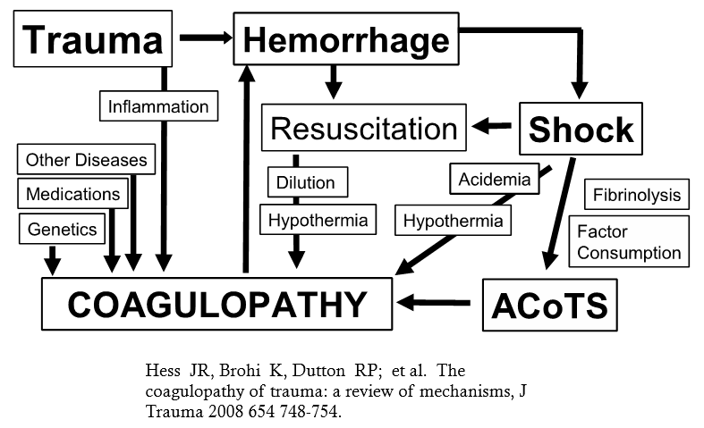
Trauma induced coagulopathy

Slide 9
ACoTs
ACoTS is associated with INCREASED MORTALITY (up to 8 X and 4 X increase at 24 hours and 30 days resp.), more blood transfusions, longer ICU and hospital stay, and higher incidence of multiple organ failure.

Slide 10
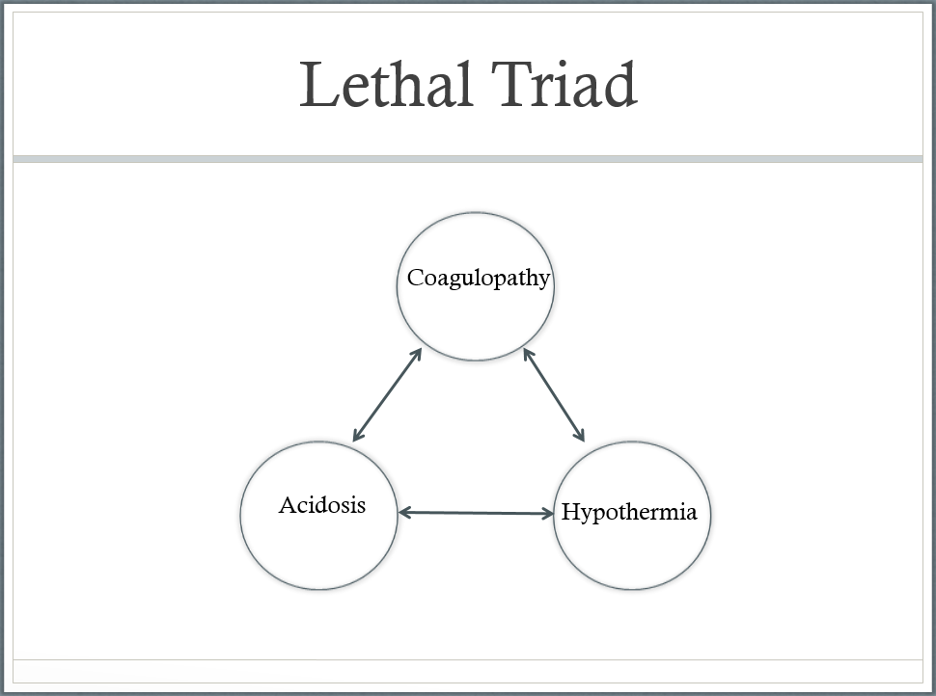
Lethal triad
(ATLS 10th Edition)

Slide 11

Signs & symptoms of shock
Tachycardia
Tachypnea
Decreased capillary refill
Hypotension
Narrow pulse pressure
Altered mental status
Cyanosis, pallor,
Diaphoresis
Hypothermia
Decreased urine output
Absent pulse oximetry signal*
+FAST/CT*

Slide 12
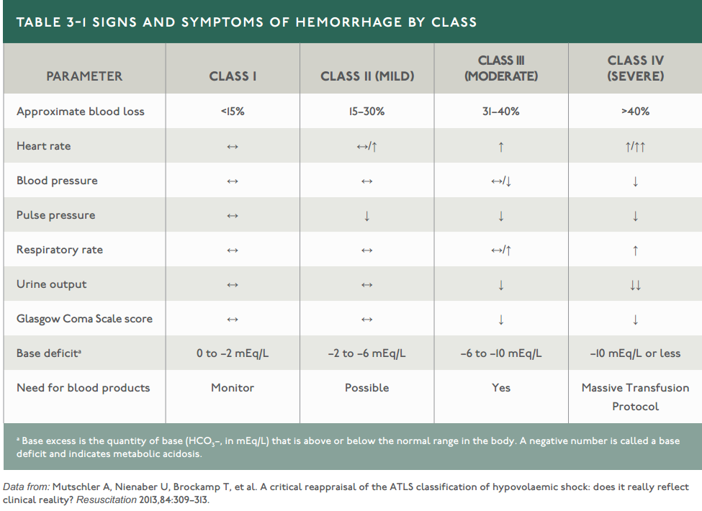
Signs and Symptoms in summary
(ATLS 10th Edition)

Slide 13

TACHYCARDIA
> 160 – Infants
> 140 – Preschool child
> 120 – School age to puberty
> 100 – Adult

Slide 14

Age
Athletes
Pregnancy
Medications
Hypothermia
Pacemaker
Beware UNUSUAL presentations
(ATLS 10th Edition)

Slide 15
CATEGORIES | TYPES | SSX | ASSESSMENT | INTERVENTION
HYPOVOLEMIC | Hemorrhagic Chest, Abdomen, Pelvis, Retroperitoneal, Extremities, TAI | Tachy/ Brady Pallor, Weak thready pulse, Cold Clammy Skin Normal/ Low GCS CRT prolonged | External Bleeding source Distended abdomen DPL/ US Vaginal Examination | Haemorrhage control TXA Secure A,B 1-2 L Crystalloids Bloods - MTP
CARDIOGENIC | M. Infarction | SOB/ Chest Pain radiating to arm/ neck Numbness | ECG: STEMI/ NSTEMI Low GCS | Secure A,B Morphine titrate S/L Nitrates 1/1(after volume status addrs) Treat Arrythmias CPR as needed Alert Cardiologist
 | Blunt Cardiac Injury | SSX of heart failure | Sternal #/tender Haemo/Pneumothorax Arrythmias | Secure A,B Treat Dysrhythmias Surgical repair(CTC)
(ATLS 9th & 10th Edition)

Slide 16
CATEGORIES | TYPES | SSX | ASSESSMENT | INTERVENTION
OBSTRUCTIVE | T. Pneumothorax | Tachycardia, SOB/ Chest pain Asymptomatic | Tracheal Deviation Distended neck vein Tympany Absent breath sounds | Needle Decompression Chest Tube
 | Cardiac Tamponade | Crackles, Tachypnoea | Beck Triad ECG: Electrical Alternans / PEA Pulsus Paradoxus Ultrasound | Pericardiocentesis Activate CTS IV Dopamine 0.5mcg/kg/min IV NS 500cc
 | Massive Hemothorax | Tachycardia SOB/Chest Pain | Tracheal Deviation Flat neck veins Dullness percussion Absent breath sounds | Chest tube, Fluids + Bloods Alert surgical team
DISTRIBUTIVE | Neurogenic shock | Full bounding pulse, Wide pulse pressure Tachypnoea, Bradycardia Pink, Warm, | Paradoxical breathing | B – intubate if respiratory failure C – Fluids + Vasopressor
(ATLS 9th & 10th Edition)
Notes:
Beck Triad:
Hypotension
Jugular venous distention
Muffled heart sounds
Dnt confused with Tension pneumothorax:
Hypotension
Jugular venous distention
Absent breath sounds

Slide 17
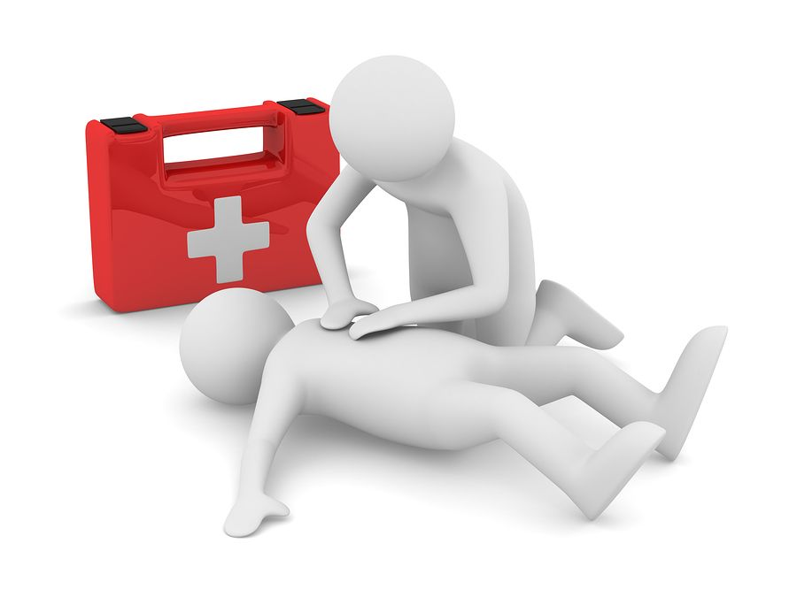
Management

Slide 18
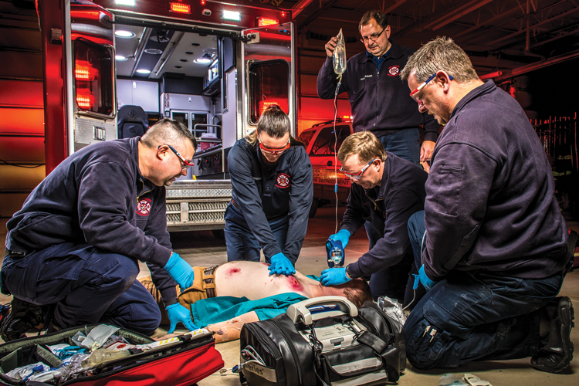
Pre-Hospital
Catastrophic Hemorrhage Control
ABCDE - 10s
Maintain Airway, Oxygen
C-Spine, Splints
IV assess and Fluids on the way
Alert receiving center for preparation.
Remember information on time of injury, event/ mechanism of injury and patient’s history is important!
Notes:
ATLS Primary Survey:
A -Airway and Cervical spine restriction
B -Breathing and Ventilation
C -Circulation and Haemorrhage Control
D -Disability : Neurology status
E -Exposure and Environmental Control

Slide 19
TRIAGE
Step 1
Red Zone
Step 1 & 2 attempt to identify most injured patient
Step 2
Red Zone
Yellow Zone

Slide 20
Step 3
Reassess
Yellow Zone
Step 4
Green Zone
(ATLS 10th Edition)

Slide 21
The 6 killers
Airway | Issues | Intervention
Airway | Airway Obstruction | Basic and advanced airway management
Breathing | Tension pneumothorax | O2, needle decompression and chest tube
 | Open Pneumothorax | O2, 3 way seal bandage and chest tube
 | Massive Hemothorax | O2, Chest Tube
 | Tracheo-branchial injury | O2, Expect difficult airway , Surgical treatment
Circulation | Cardiac Tamponade | O2, Pericardiocentesis

Slide 22
Injury prediction
(ATLS 10th Edition)

Slide 23
(ATLS 10th Edition)

Slide 24
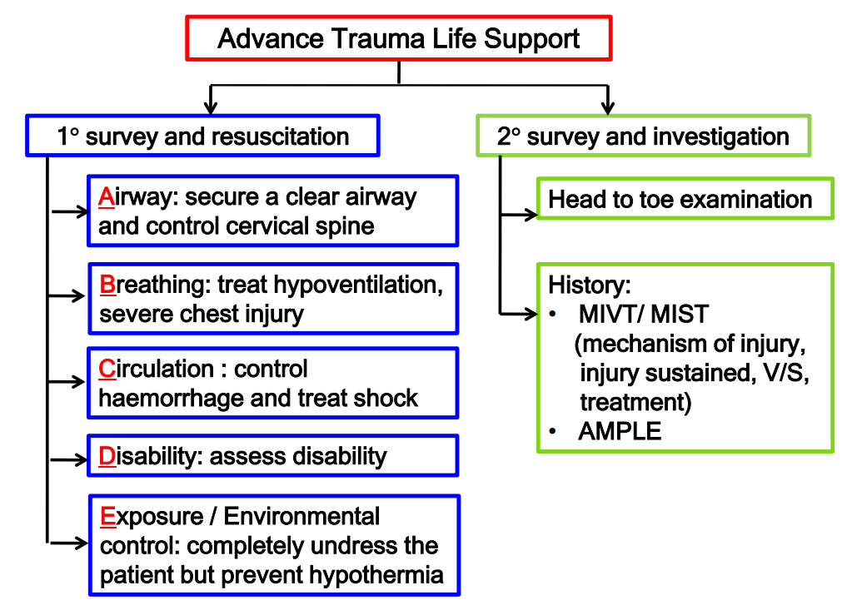
ATLs approach
Don’t Forget to Complete The Secondary Survey
Notes:
A - Allergy
M - Medications
P - Past Medical history
L - Last Meal
E - Event of Accident
Head-to-Toe/ Finger in every orifice
CT, FAST, DPL;
Extremities Xrays;
Angiography;
Endoscopy

Slide 25
2 critical steps

Slide 26
Any injured patient who is cool and tachycardia is in
“SHOCK” until proven otherwise!

Slide 27
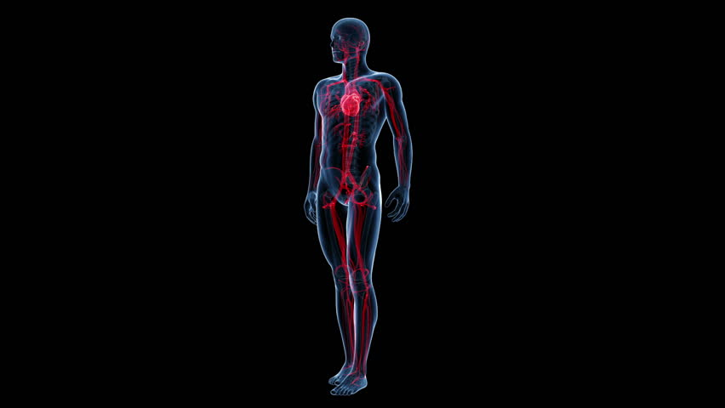
Source of Bleeding 1+4 SCALPR
< 0.2 L
1.5 - 2 L /Lung
Scalp, Skin & Street
&
Chest
Abdomen
Long Bones
Pelvic + Retroperitoneal
0.25 L
2 – 4 L
40-80% TBW
1 – 2.5 L
20 - 50% TBW
0.5 – 1.5 L
10 - 30% TBW
STLS

Slide 28
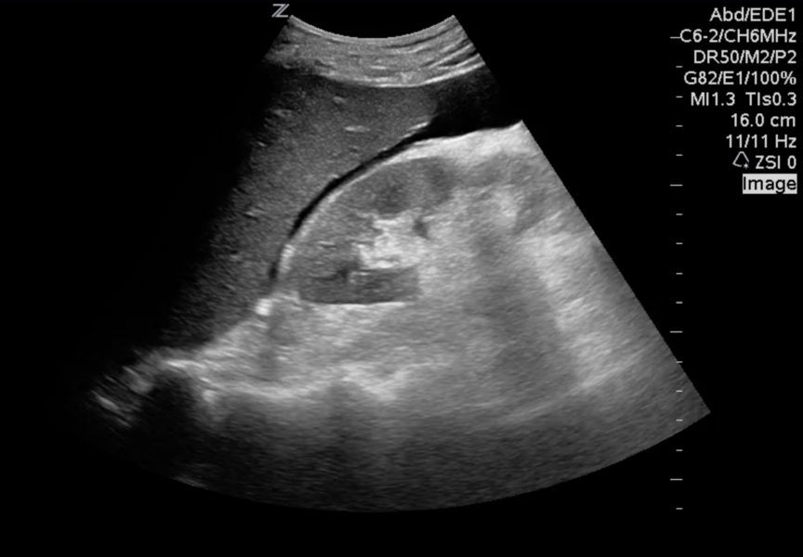
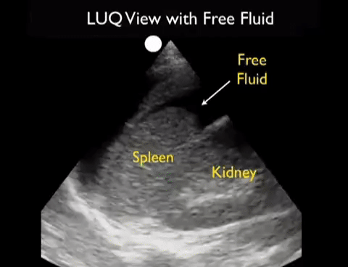
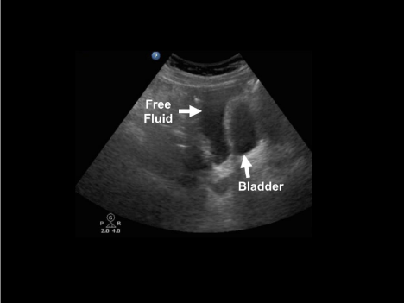
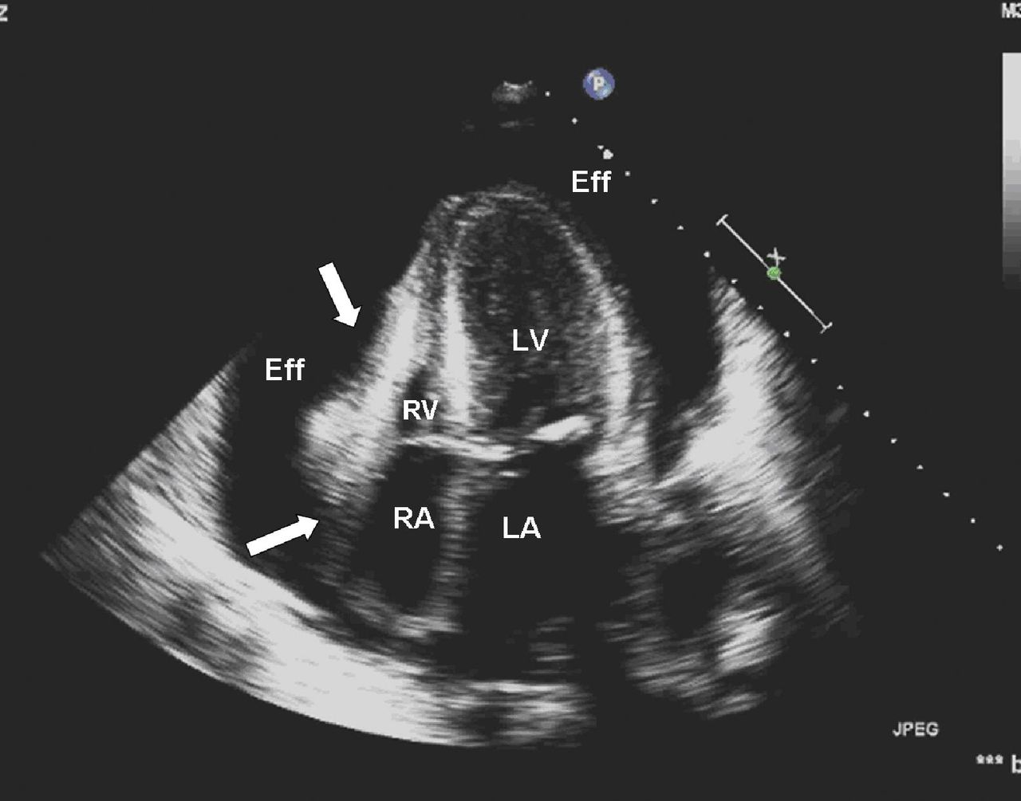
Efast
Remember -
Rule in ! Not to rule out.

Slide 29
EFAST
Normal?
Bleed?

Slide 30
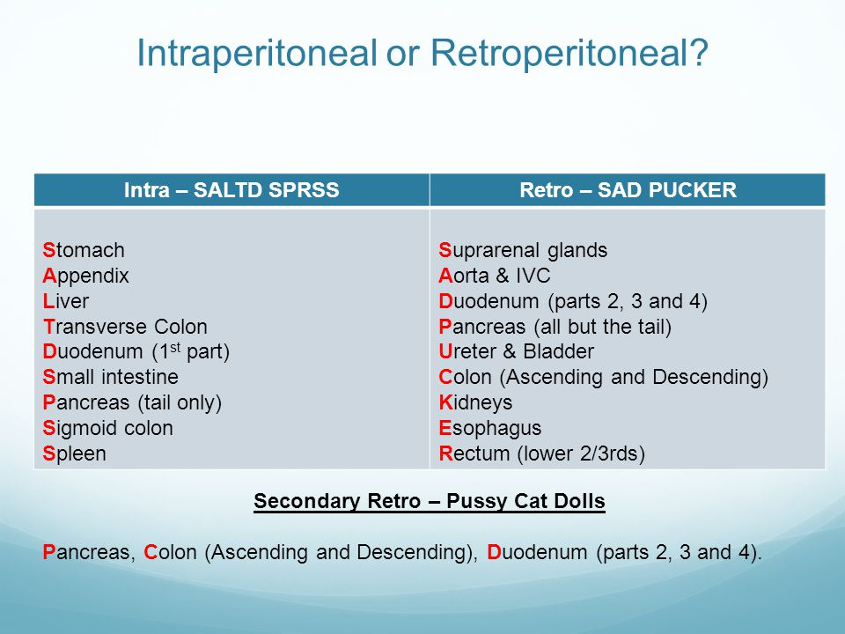
Peritoneal bleeding

Slide 31
Estimate the losses!
By patient’s initial presentation
(ATLS 9th &10th Edition)

Slide 32
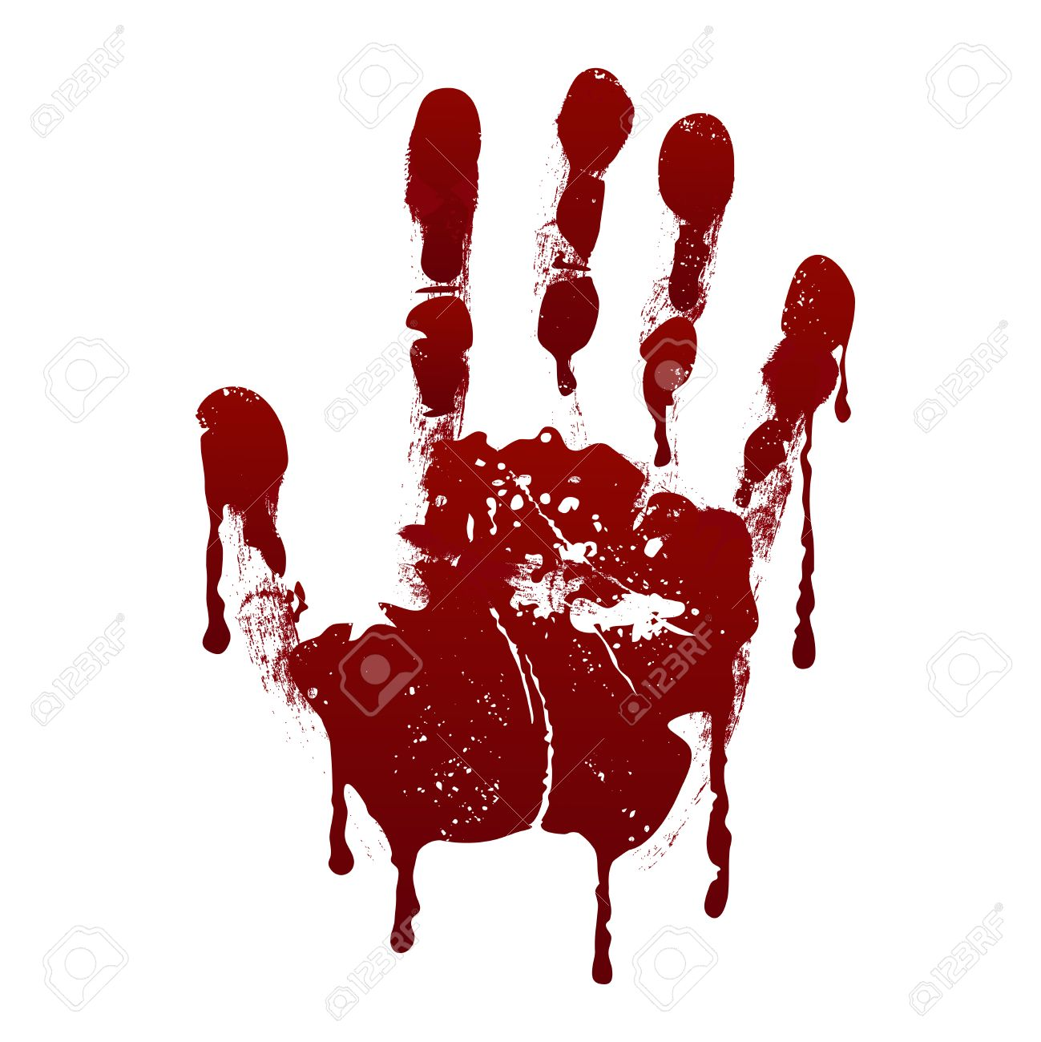
Strategy
Assess and manage “ABC”.
Establish “IV -Oxygen –Monitors”.
Insert “2 large bore” cannulae in peripheral Veins/ CVL/ IO
Infuse “1 - 2 L” of warm crystalloids rapidly.
ECG heart rate monitoring,
Continuous pulse oximetry, ET CO2 monitoring.
Monitor arterial blood pressure, GCS, and peripheral perfusion.
IV Tranexemic Acid 1g Stat
Insert NG tube and bladder catheter.

Slide 33
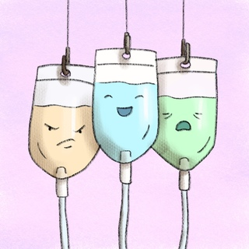
Fluids
Bolus therapy
Children : 20 cc/kg
Adults : 1- 2 liters
Monitor response
Repeat if necessary
After 2nd bolus: need blood txn
10cc/kg

Slide 34
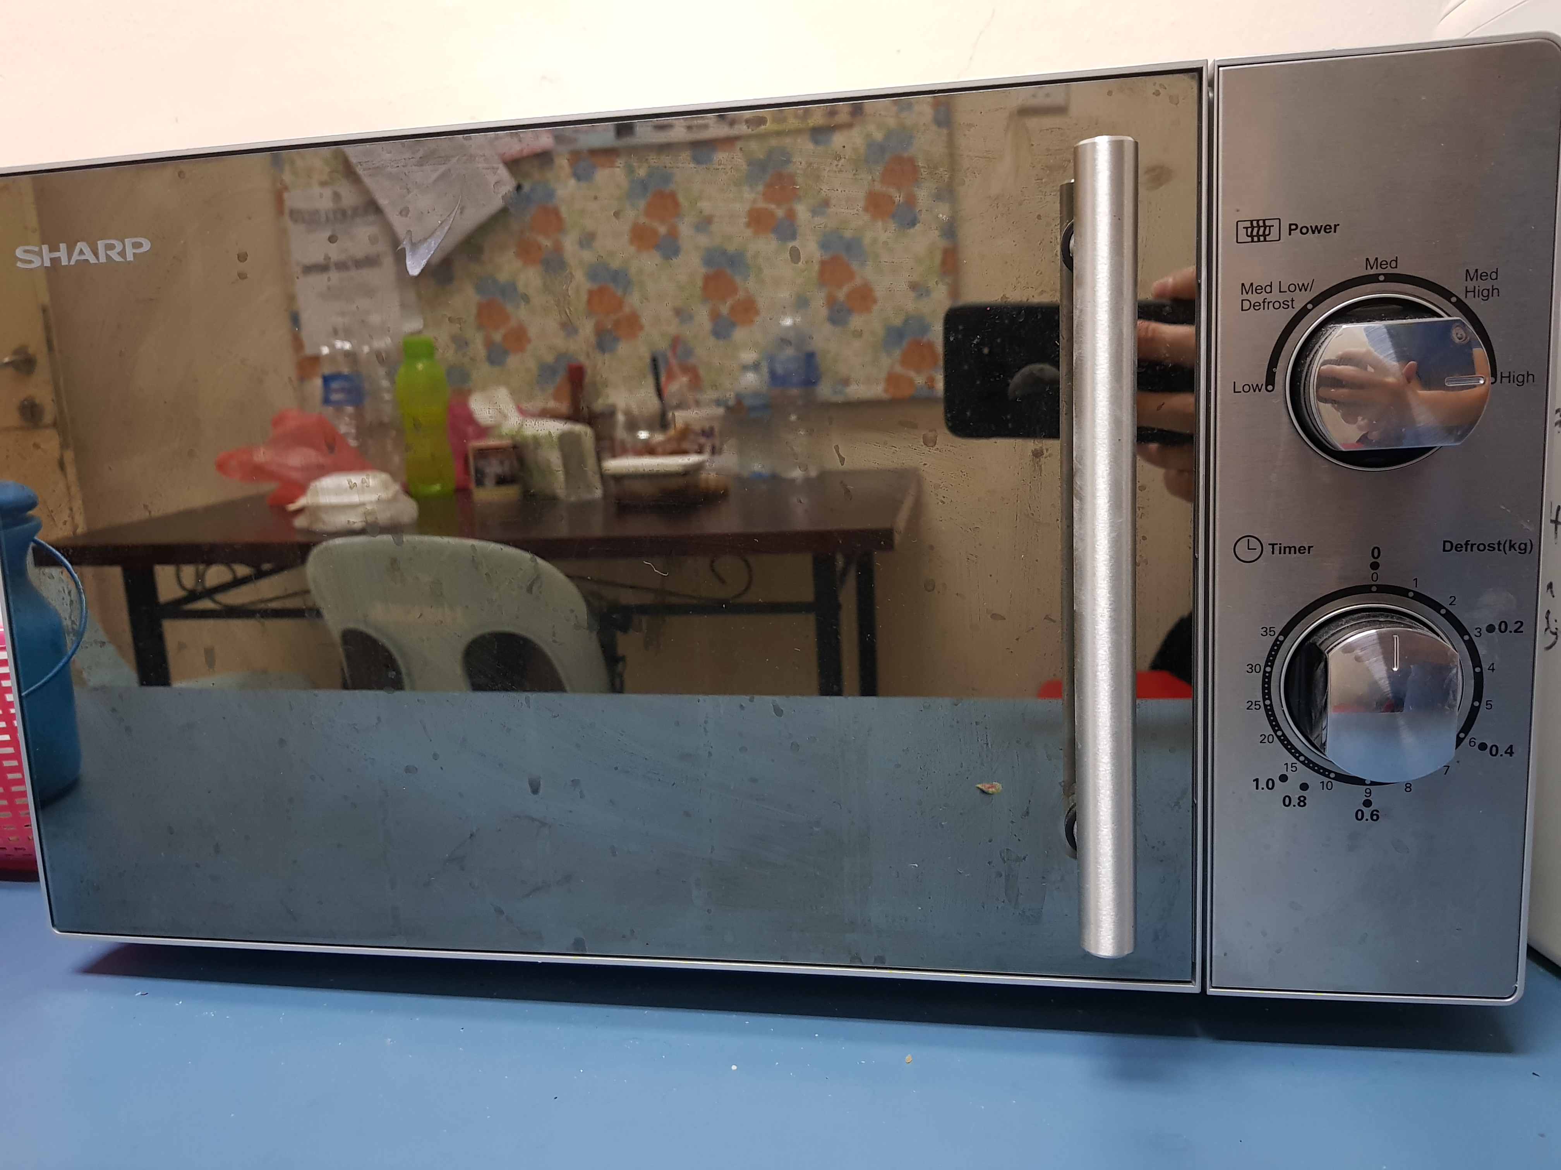
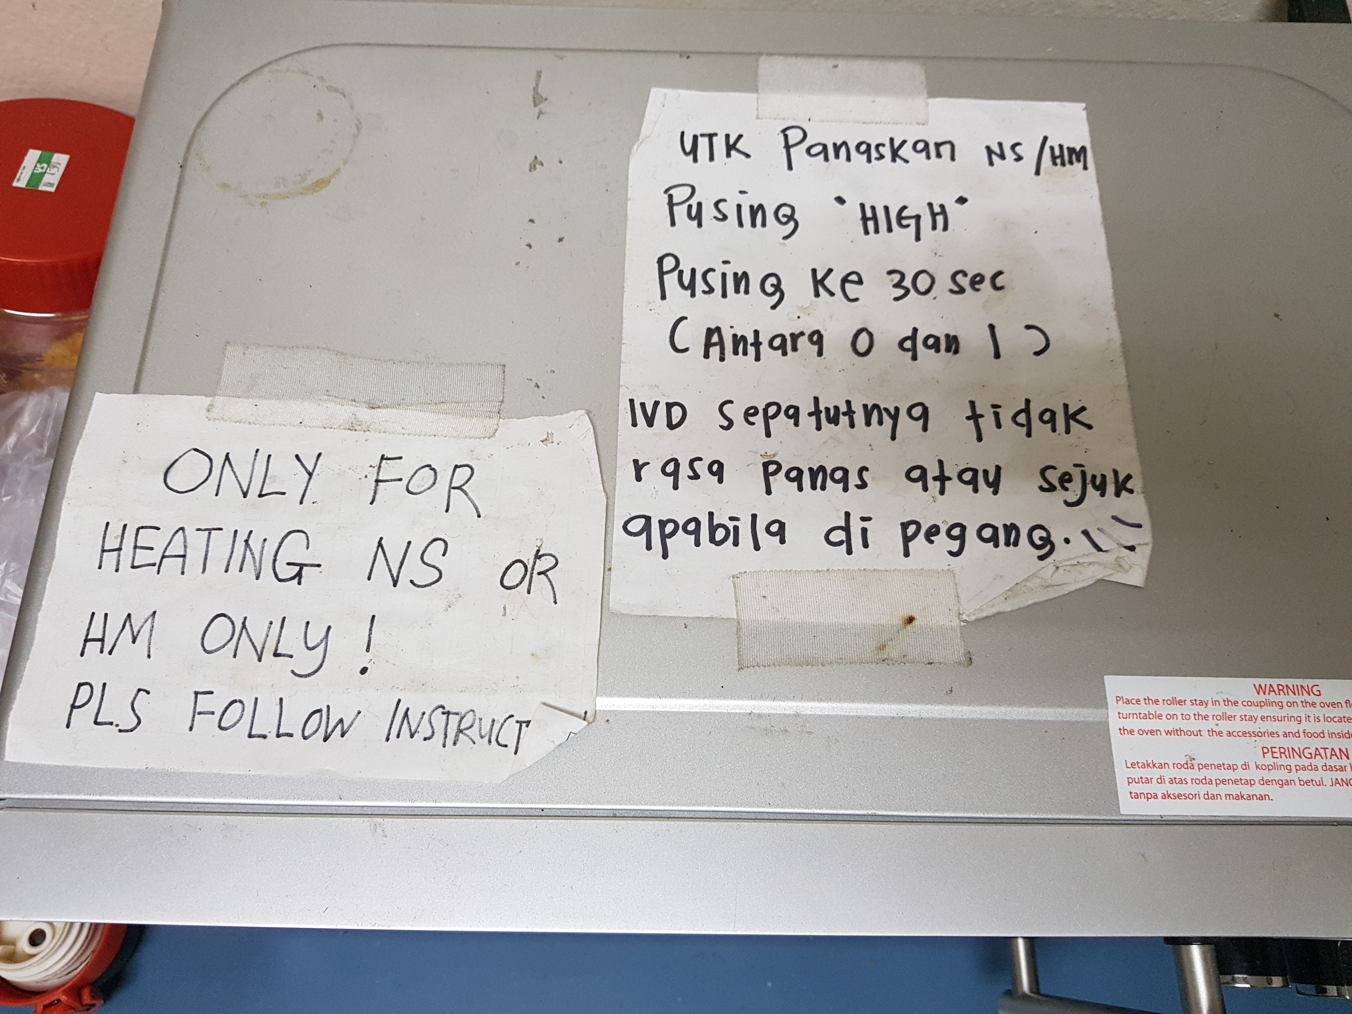
Beware of hypothermia
ETD HWKKS

Slide 35
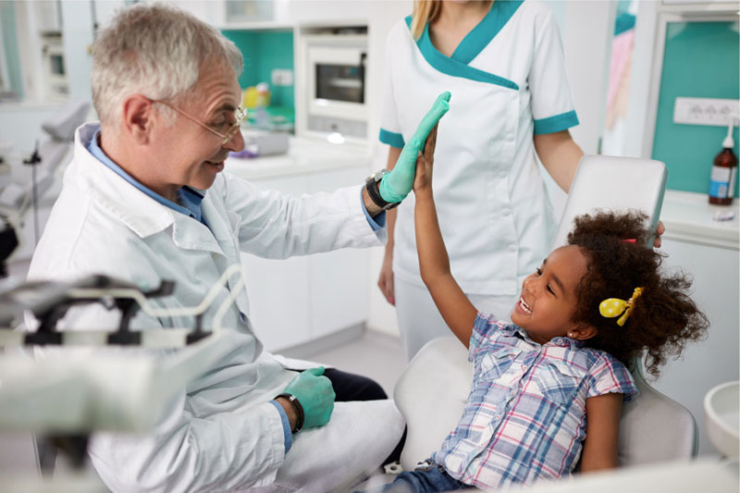
Assess the “RESPONSE” to initial volume therapy!

Slide 36
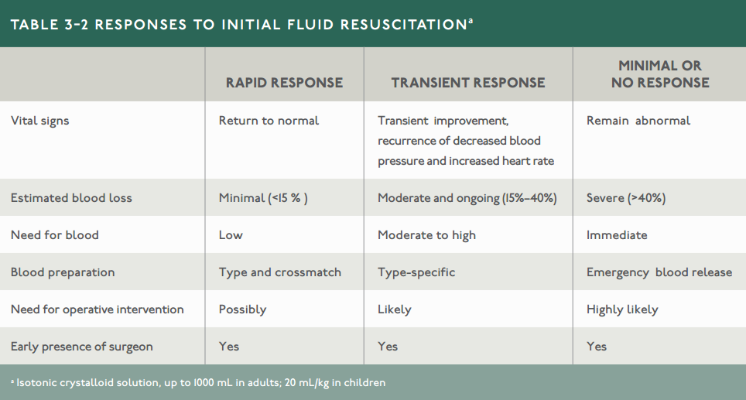
Response to Initial fluid resus!
(ATLS 10th Edition)

Slide 37
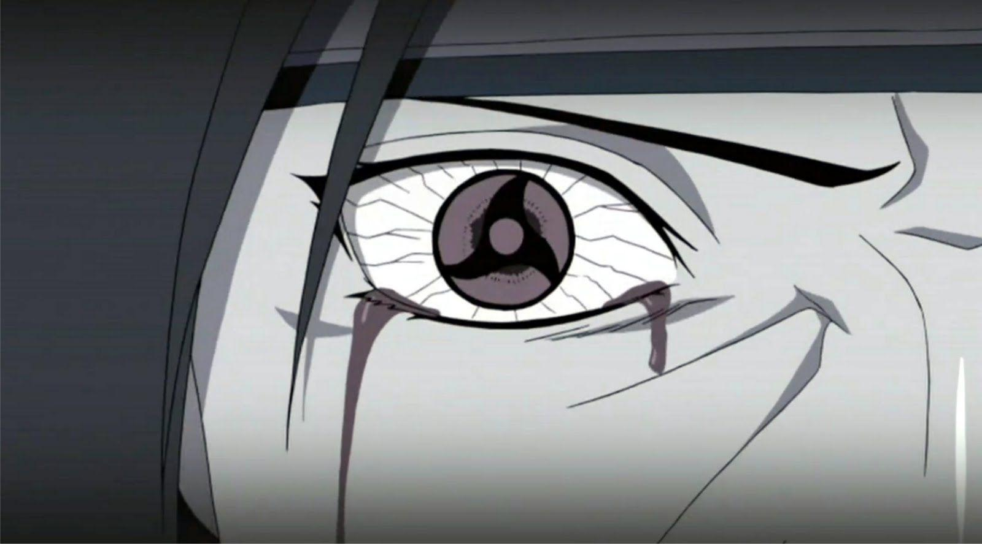
Failure to respond? Look hard!
Blunt myocardial injury
Cardiac tamponade
Tension pneumothorax
Neurogenic shock
Ongoing haemorrhage
Retroperitoneal bleed
Internal organ injury

Slide 38
(ATLS 9th Edition)

Slide 39
(ATLS 9th Edition)

Slide 40
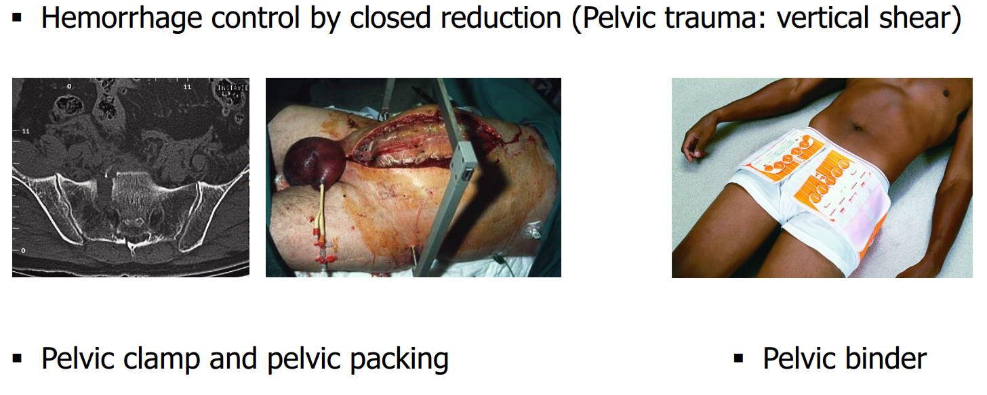
Pelvic Trauma

Slide 41
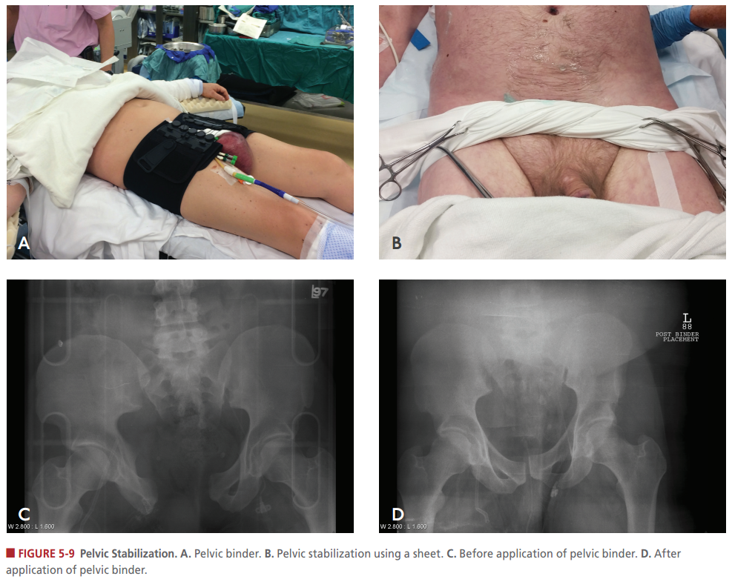
Pelvic Clamping
Where do we tie / Clamp?
Anatomy marker?

Slide 43
(ATLS 9th Edition)

Slide 44
Nunez – abc scoring
2 out of 4 criteria
Criteria
Tachycardia > 120 b/min
SBP < 90 mmHg
Positive eFAST
Penetrating injury

Slide 45
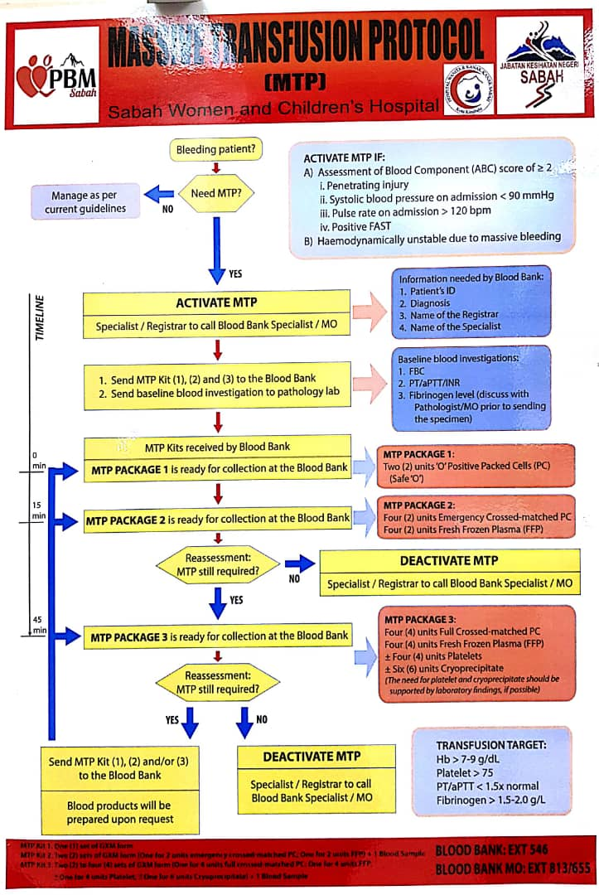
Massive Transfusion protocol
Alert Blood Bank MO
Blood Bank EXT : 546

Slide 46
End point of resuscitation
Stop the bleeding
Restore volume
Adequate Urine output
0.5 - 1.0 cc/kg/hr
Tissue Oxygenation measurement
Normalization of Oxygen delivery DO₂
Normal Serum Lactate levels

Slide 47
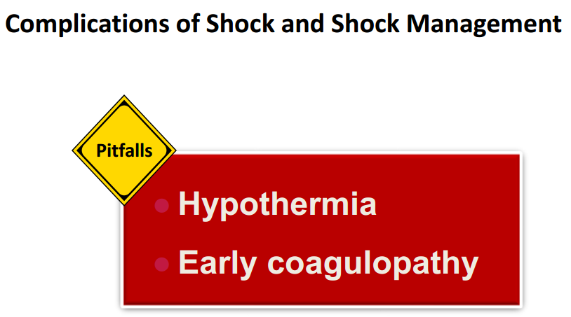
pitfalls

Slide 48
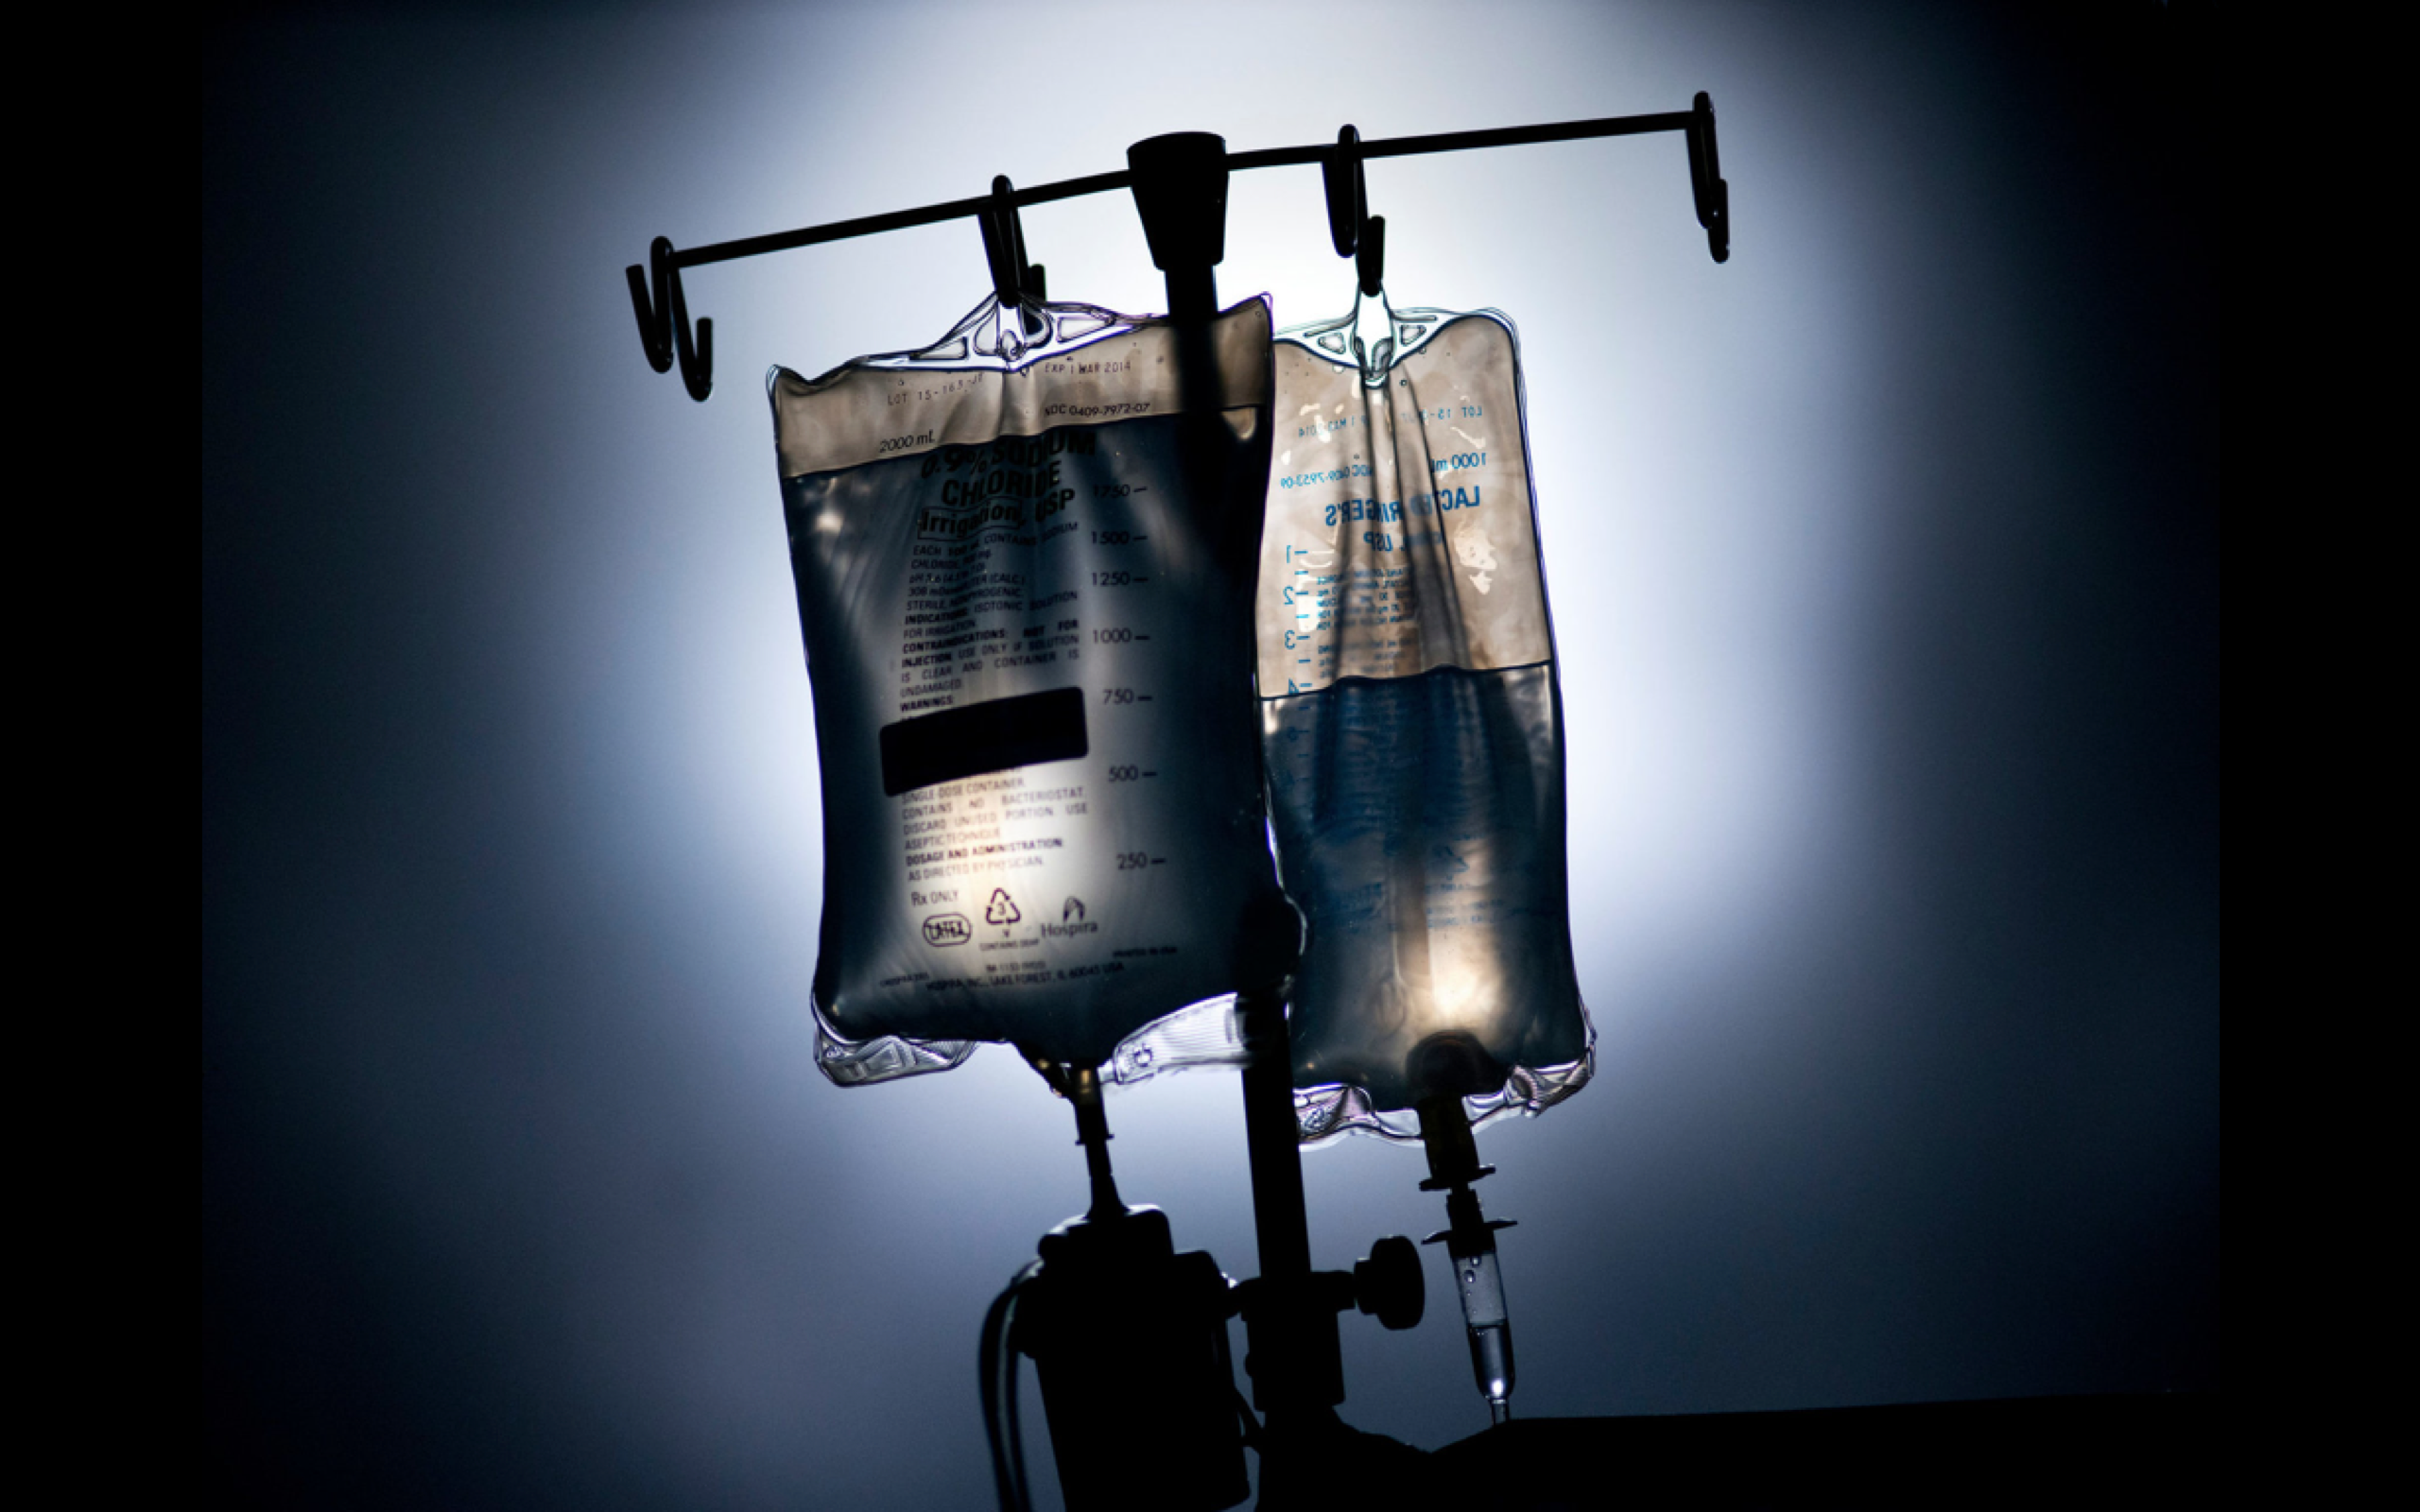
Damage control resuscitation
Permissive Hypotension
Haemostatic Resuscitation
Prevent Acidosis, Hypothermia, Hypocalcemia
Damage Control Surgery

Slide 49
Viscoelastic haemostatic assay thromboelastrography (TEG)

Slide 50

Permissive hypotension in trauma
“One of the most controversial issues in trauma care today is restricting intravenous fluid resuscitation in hypotensive trauma patients who have uncontrolled haemorrhage”

Slide 51
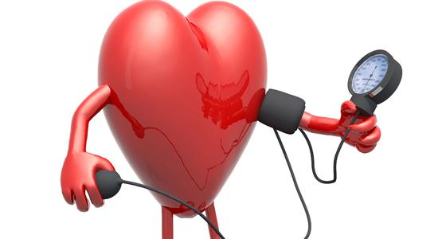
PERMISSIVE HYPOTENSION
SBP 80 to 90 mm Hg (trauma),
If severe TBI (GCS<8), keep SBP ≥ 100 mmHg (50 to 69 years)
≥ 110 mm Hg (15 to 49 years / > 70 years) (ATLS 10th Edition)
Not applicable in
Myocardial disease,
Cerebral ischemia, or
Traumatic brain injury.
Pregnancy
Children <12 YO
Notes:
Objective:
balance the risk of decreased tissue perfusion with the benefits from the prevention of coagulopathy.

Slide 52
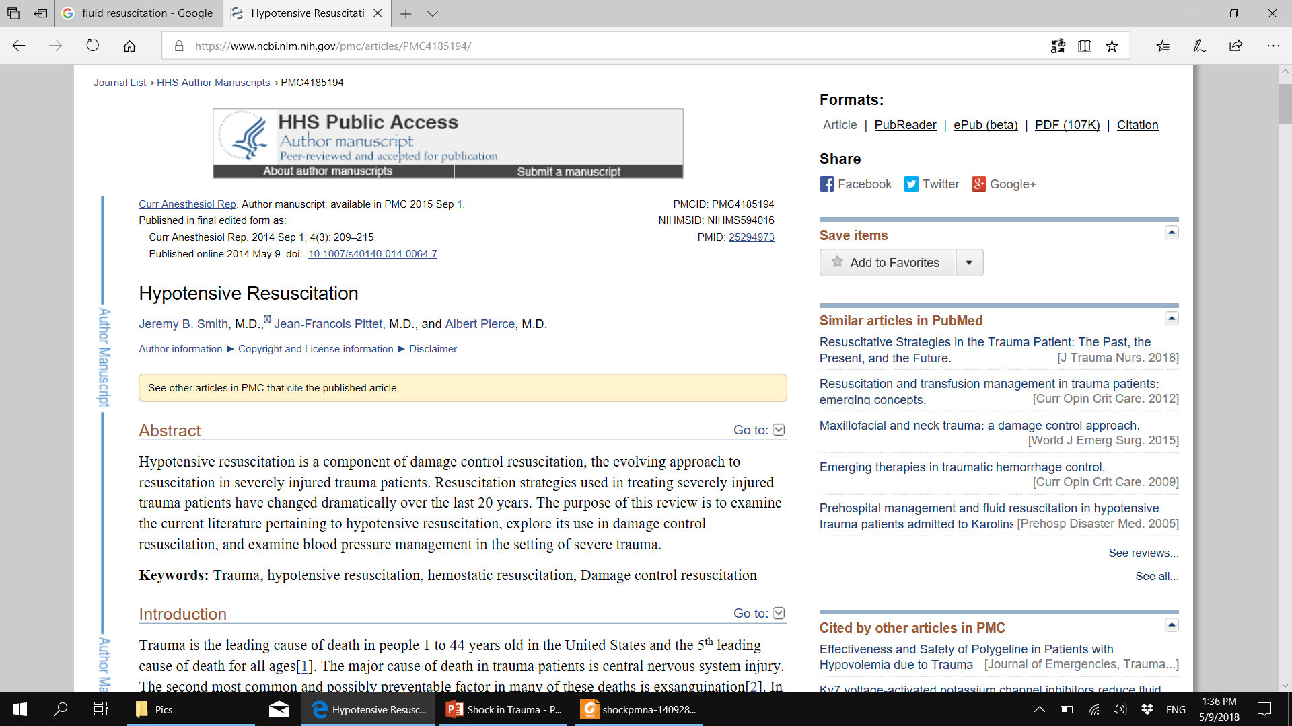
Hypotensive Resuscitation
https://www.ncbi.nlm.nih.gov/pmc/articles/PMC4185194/

Slide 53
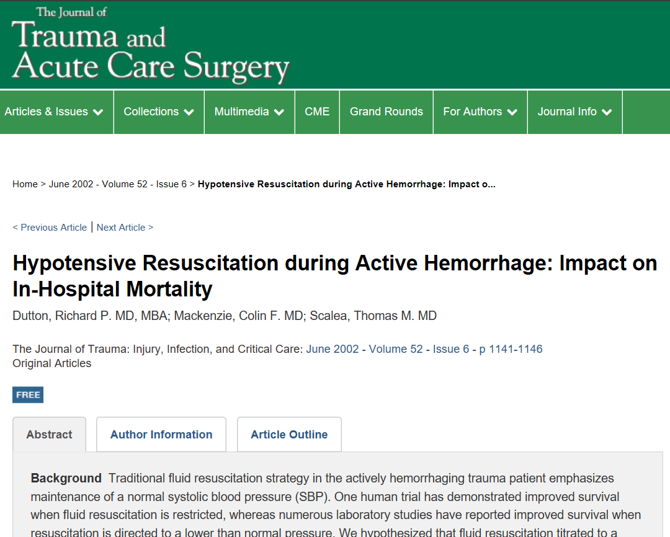
Hypotensive Resuscitation
https://journals.lww.com/jtrauma/Fulltext/2002/06000/Airbag_induced_Lethal_Cervical_Trauma.20.aspx

Slide 54
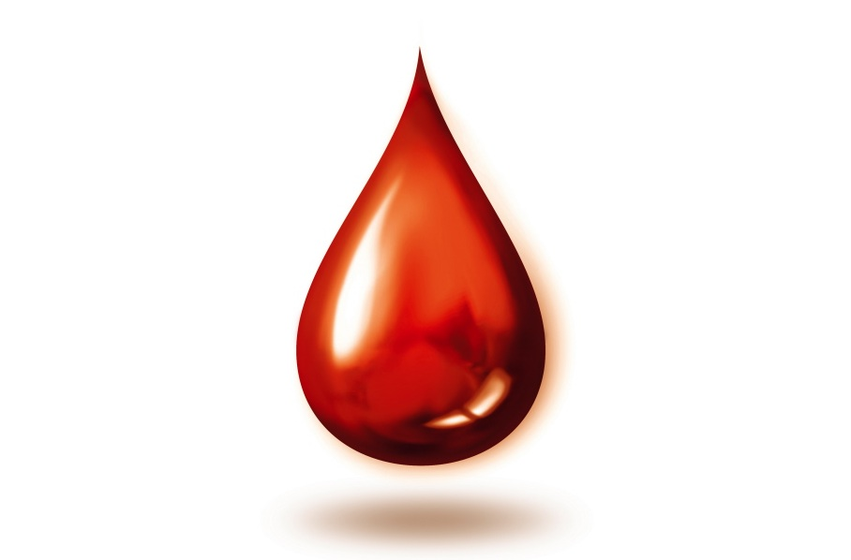
Haemostatic resuscitation
Early transfusion to maintain circulating volume
Minimisation of crystalloid use – dilutional effect, dislodges clot, induces hypothermia
Reduce coagulopathy
Keep warm
Prevent acidemia

Slide 55
Notes:
PROPPR trial – FFP: Platelet: RBC in 1:1:1 better than 1:1:2.

Slide 56
Fluids
Bolus therapy
Children(<40kg) : 20 cc/kg
Adults : 1- 2 liters
Monitor Effect
Repeat if necessary
After 2nd bolus: need blood txn
10cc/kg
(ATLS 10th Edition)
Notes:
Excessive fluid in previous resus method:
Oedema, compartment syndrome and acute lung injury
Exacerbation of anaemia, thrombocytopenia and coagulopathy due to haemodilution (‘dilutional coagulopathy’)
Exacerbation of bleeding due to possible clot disruption

Slide 57
Role of blood gas
Base deficit - new criteria for the hemorrhage classification.

Slide 58
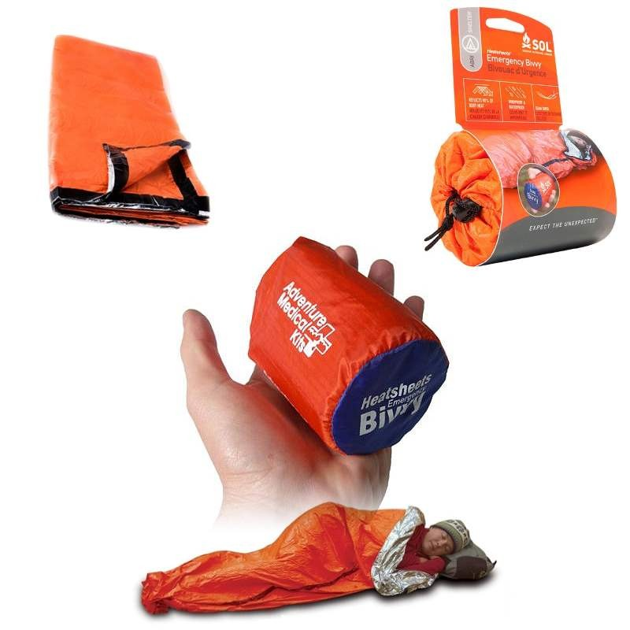
Rewarming
Maintain normo-thermia (36-37 Celsius)
Remove wet clothes,
Use warmed fluids (e.g. Level 1 Fluid Warmer),
Bair Hugger or warm blankets,
Insulating foils
Fluids warmth to 39 Celsius prior transfusion
Notes:
If the hypothermia persists or quickly relapses despite these maximal rewarming efforts,
ongoing hemorrhage and unresolved tissue hypoperfusion and hypoxia should be suspected

Slide 59
(ATLS 10th Edition)

Slide 60
(ATLS 10th Edition)

Slide 61
(ATLS 10th Edition)

Slide 62
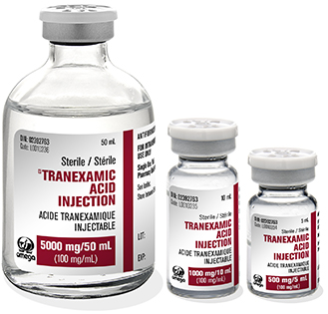
TXA
Anti-fibrinolytic: Tranexamic acid (TXA) – CRASH-2 trial.
TXA 1g/10m, then 1g/8h .
Within 3h of injury , best within 1h.
Suggest to give even in pre-hospital setting .

Slide 63
Notes:
This paper concluded TXA use reduce mortality

Slide 64
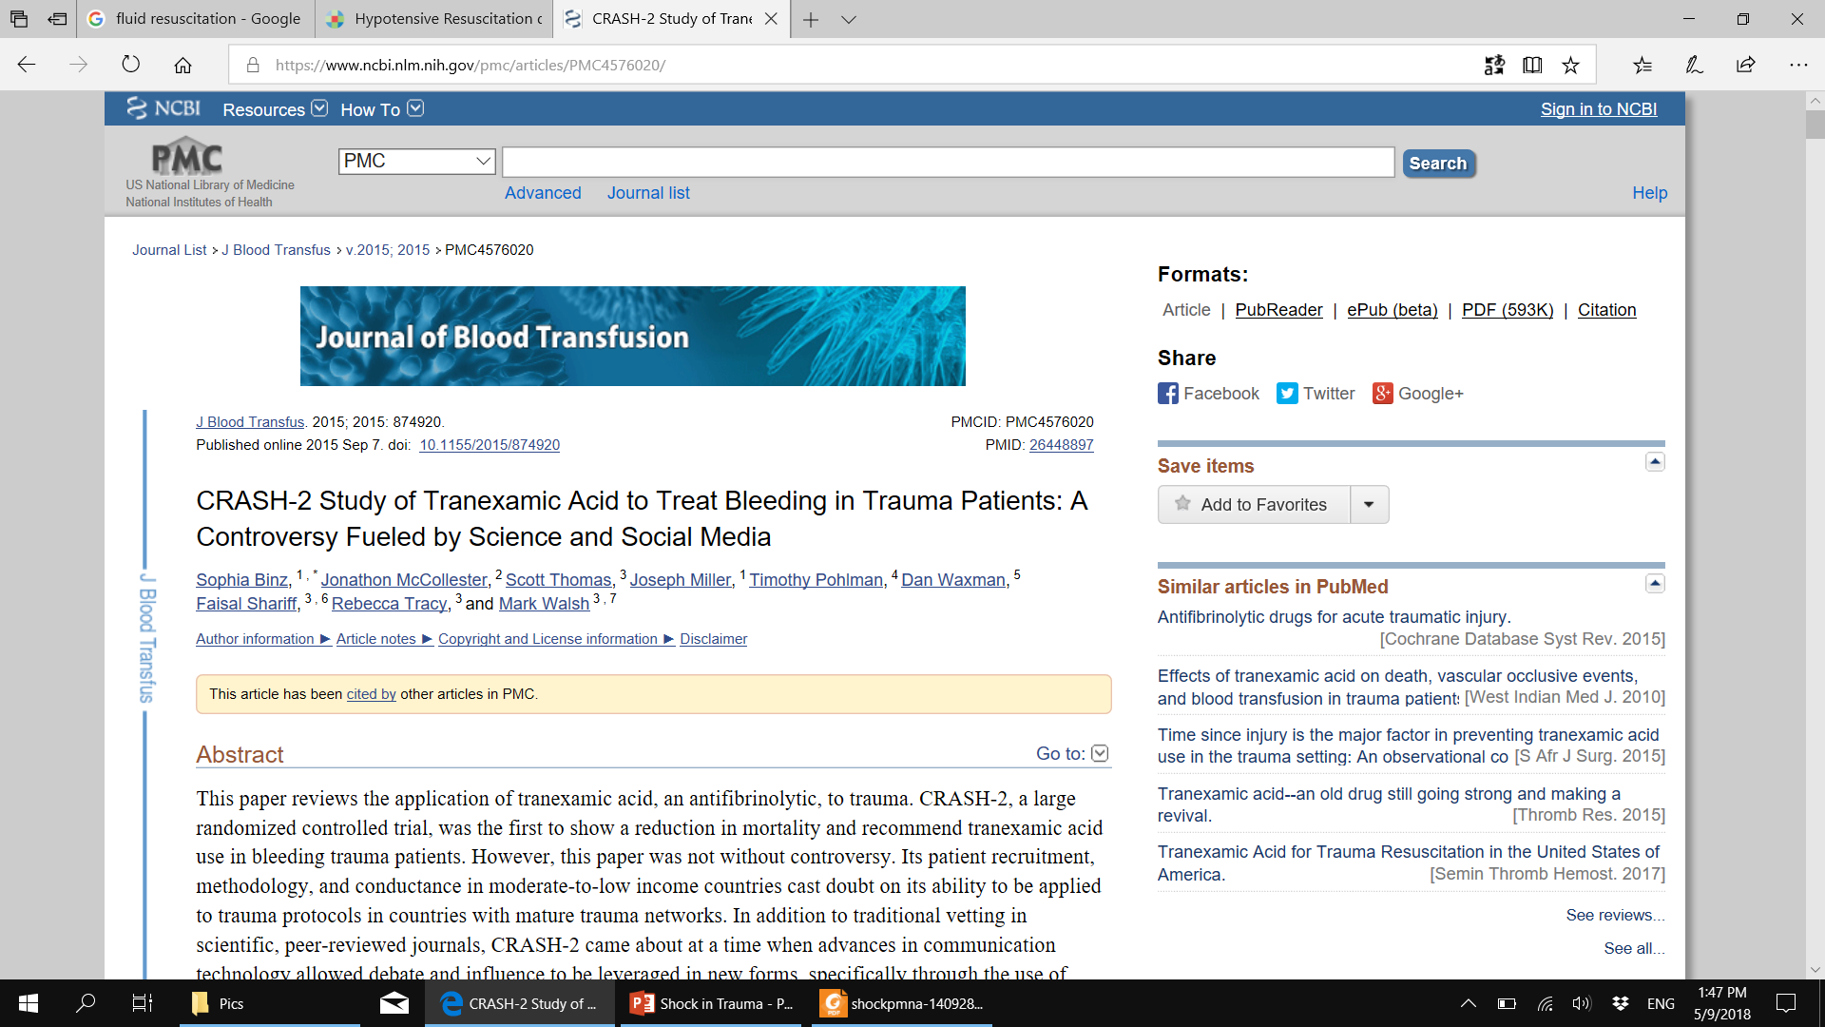
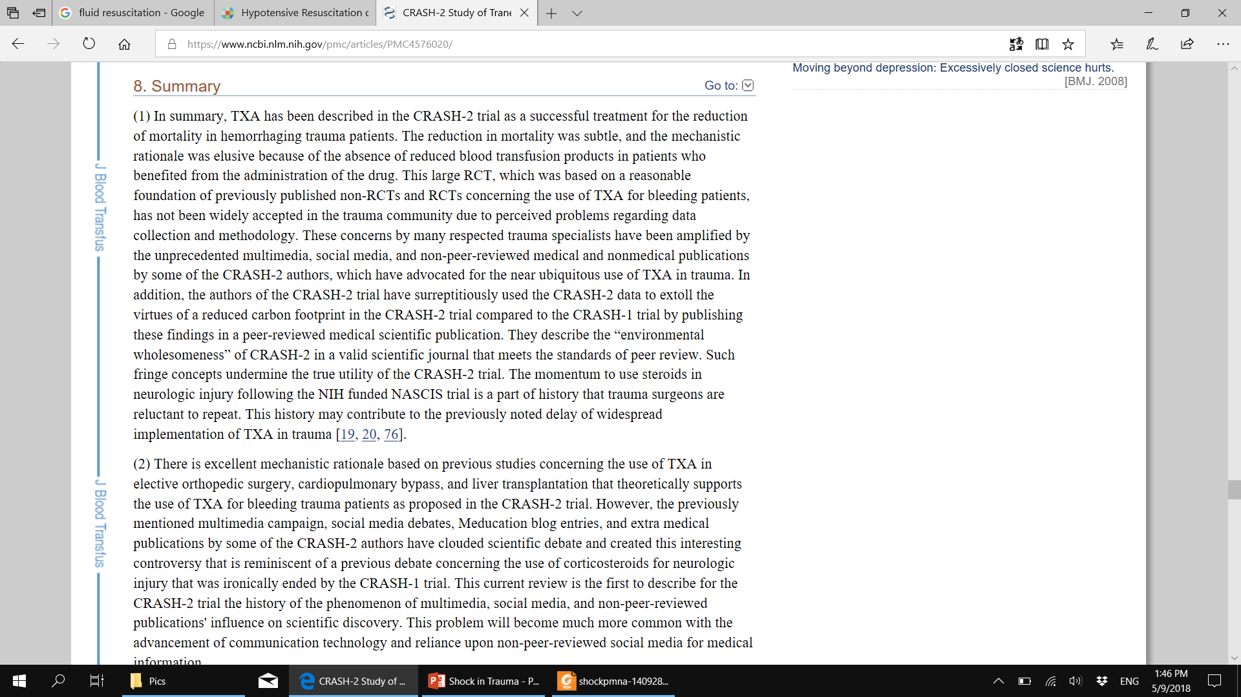
CRASH-2 TXA
https://www.ncbi.nlm.nih.gov/pmc/articles/PMC4576020/
Notes:
This paper concluded after 3 hours, administration of TXA is of no effect.
Best hemostasis still by hemostatic suture.

Slide 65
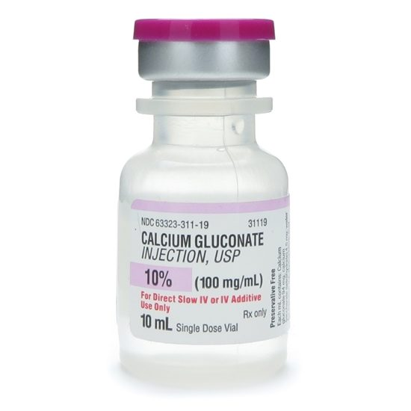
Calcium
Calcium:
Acute hypocalcaemia due to massive transfusion (citrate binds to Ca).
Monitor and maintain ionized Ca level in normal range (1.1-1.3 mmol/L).

Slide 66
Damage control resuscitation
Recognition
Haemostatic Resuscitation
Rapid movement to OT without waiting for normal vitals
Initial Surgery to only secure bleeding
Post-operative care in ICU settings
Re-operation in 24-36 H
Life in the fast lane

Slide 67
Rapid movement to the operating theatre (OT)
“scoop and run” approach
Address immediate life threats prehospital or in the emergency department
Permissive hypotension may be tolerated in penetrating vascular trauma pending surgical repair
Avoid unnecessary delays in transit to the OT

Slide 68
Initial surgery
Short time in OT
Limited focused surgery to control haemorrhage and decontaminate
Pack
Partially resect organs
Staple off and remove injured bowel
Fibrin sealants
Leave abdomen open

Slide 69
Move to ICU
Restore near normal physiology
Correct lethal triad: rewarm, correct acidosis and correct coagulopathy
Optimise ventilation
Plan re-operation once stable

Slide 70
Re-operation at 24-36 hours
Remove packs
Definitive surgery
Formally close abdomen

Slide 71
references
https://lifeinthefastlane.com/ccc/damage-control-surgery/
https://accessmedicine.mhmedical.com/book.aspx?bookID=1658
https://www.ncbi.nlm.nih.gov/pmc/articles/PMC4185194/
https://journals.lww.com/jtrauma/Fulltext/2002/06000 Airbag_induced_Lethal_Cervical_Trauma.20.aspx
https://www.ncbi.nlm.nih.gov/pmc/articles/PMC4576020/
https://depts.washington.edu/surgstus/Clerkship/Lectures/print/Shock_Foy08.ppt
https://www.slideshare.net/.../management-of-shock-in-acute-trauma-setting
yorkcrnaprogram.weebly.com/uploads/6/1/3/5/6135222/bonjo.ppt
https://www.hindawi.com/journals/isrn/2013/783478/
https://jintensivecare.biomedcentral.com/articles/10.1186/s40560-016-0197-5#Sec19

Slide 72


